Slide 1

Team: 4 - Legalytics Squad
Topic: Content Moderation Based On ML
Teammates: Ravid Dimant, Veronika Sorochenkova, Tal Shalom, Alona Zafrir, Daniel Niazov
Final Project Presentation

Slide 2

Warning
This presentation will contain harmful speech

Slide 3

Case-Study
Hate-Buster
AI system which designed to monitor and eliminate hate speech that could be published in social media platforms. Classifies each post as either hateful or not hateful.
“Hate-Buster aims to make conversations on social networks safer. Therefore, it is its goal to ensure that the discourse on said networks is free from hate speech.” (Hate-Buster’s ToS)

Slide 4


Hate-Buster
Twibber
Contract to use Hate-Buster’s system:
“Hate-Buster commits to an accuracy level of 75% for hate-speech detection on Twibber’s platform as part of its mission to eradicate hate speech across online platforms”
Based on the contract:
“Twibber is committed to maintain no more than a 15% rate of unjustified removals of user content, due to its steadfast commitment to maintaining freedom of speech while maintaining a safe atmosphere for all users” (Twibber’s User Agreement)
Notes:
Data drift refers to changes in the statistical properties of the input data over time, which can impact the performance of a machine learning model.
Types of data drift:
Covariate Drift: Changes in the distribution of input features.
Prior Probability Shift: Changes in the distribution of target labels.
Concept Drift: Changes in the relationship between input features and the target variable.

Slide 5
Hate-Buster
Twibber
The system fails!
Over time, Twitter’s users complain that Hate-Buster’s content moderation system failed to correctly classify hate speech, leading to the widespread visibility hate speech.
Words that are considered as slang are being mistakenly recognized as hate speech. These errors occurred because the system misinterpreted the context of the post, as part of “Data Drifting”
Contract to use Hate-Buster’s system:
“Hate-Buster commits to an accuracy level of 75% for hate-speech detection on Twibber’s platform as part of its mission to eradicate hate speech across online platforms”
Based on the contract:
“Twibber is committed to maintain no more than a 15% rate of unjustified removals of user content, due to its steadfast commitment to maintaining freedom of speech while maintaining a safe atmosphere for all users” (Twibber’s User Agreement)
Notes:
Data drift refers to changes in the statistical properties of the input data over time, which can impact the performance of a machine learning model.
Types of data drift:
Covariate Drift: Changes in the distribution of input features.
Prior Probability Shift: Changes in the distribution of target labels.
Concept Drift: Changes in the relationship between input features and the target variable.

Slide 6
Hate-Buster’s system - Data
Data:
Dataset: 2017 web dataset contains 24,802 Twitter posts , with 6% of the tweets classified as hate speech.
Preprocessing Steps:
- Data cleaning
- Tokenization
- Normalization
Feature Extraction: TF-IDF vectorization to capture the importance of words in the context of short tweets.
Notes:
אופציה 2 - פירוט בעל פה -
Data Cleaning: Removal of special characters, URLs, and unnecessary whitespace to ensure clean text data.
Tokenization: Splitting tweets into individual words or tokens to facilitate analysis.
Normalization: Converting text to lowercase to maintain uniformity and removing stop words to focus on meaningful words.

Slide 7
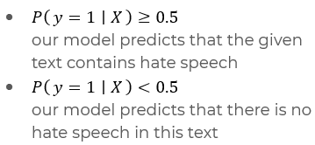
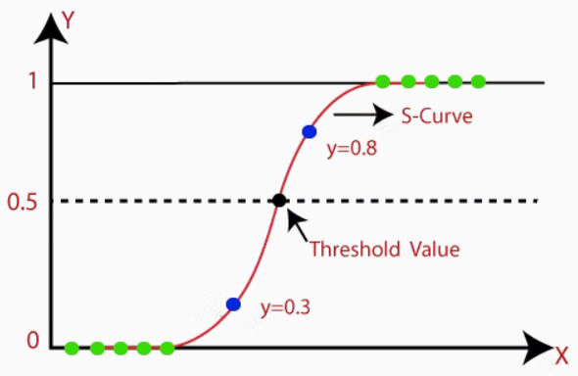
Hate-Buster’s system - Model
Logistic Regression: is a simple classification model with high explainability- we did not have a lot of data to train a more sophisticated model.
Special Parameters:
penalty='l2': L2 regularization, which helps prevent overfitting by penalizing large coefficients.
class_weight='balanced': adjusts weights inversely proportional to class frequencies in the input data to handle class imbalance.
Decision-Making Process:
Using logistic function to model the probability that a given input belongs to a certain class - classifying hate speech.
Determine thresholded to make a binary decision. In out model threshold of 0.5 is used:
Notes:
אופציה 2

Slide 8

What is our system’s performance in identifying hate speech, and does it operate in a way that is immune to data drifting?
Our Audit’s Question

Slide 9

Why?
Complaints about exposure to hate speech and outcomes
Ensuring the company upholds self imposed and external legal obligations, alongside system efficiency.
Who?
Internal audit.
What?
Auditing the system development and the system outputs, alongside the compliance to duties imposed on the company by law.
When?
A post-deployment support.
How?
Data & model analysis and checking data drifting. Meeting the standards of the legal framework - contracts, constitutional, consumer protection.

Slide 10



Methods - Analysis Process
Dataset Analysis
Model Performance & Compliance with Legal Frameworks
Hate-Buster’s Terms of Service, contract law, constitutional rights
Data Drift Analysis

Slide 11
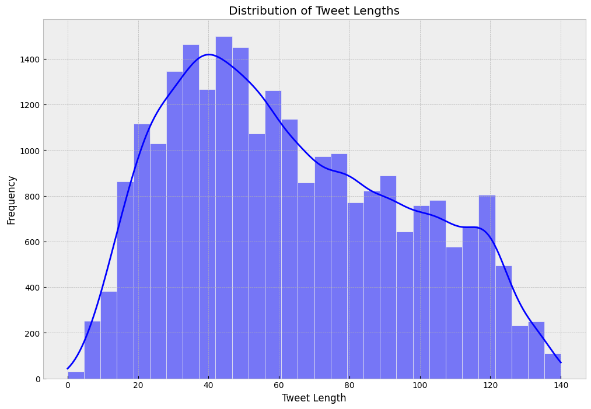
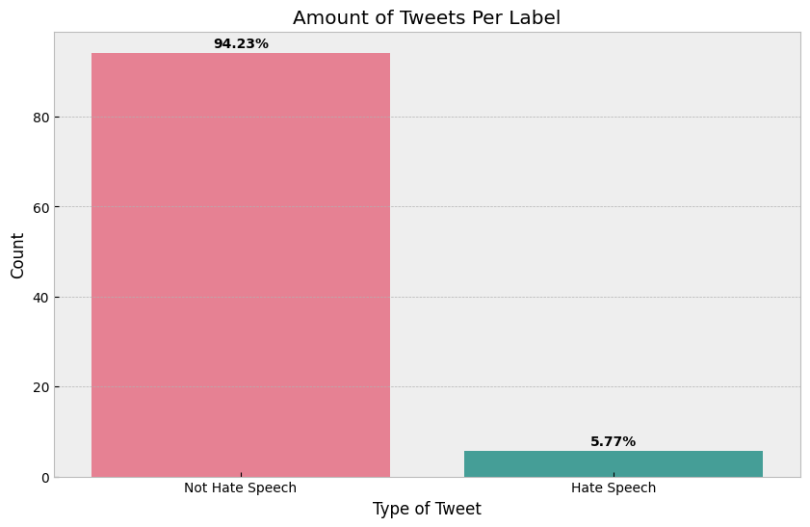
1 - Twitter Dataset Analysis
The data originates from a 2017 study by Thomas Davidson and his team at Cornell University - contains 24,802 Twitter posts
Notes:
Since most tweets are short, we used techniques like TF-IDF vectorization to capture the importance of words in the context of short texts.
To handle the imbalance in the dataset where non-hate speech significantly outnumbers hate speech, we employed methods to balance the classes in the regression model. This included techniques like oversampling the minority class or using class weights to ensure the model does not bias towards the majority class.

Slide 12
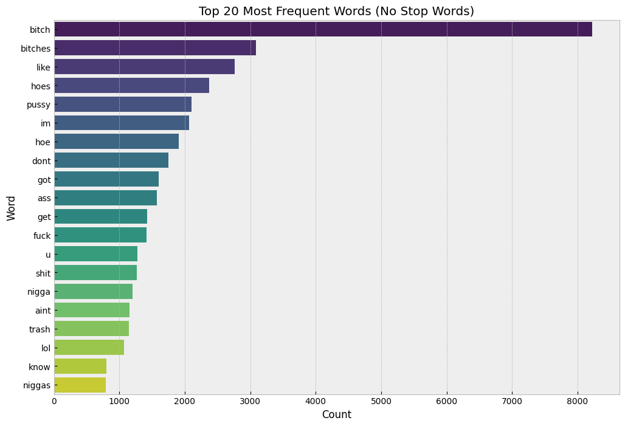
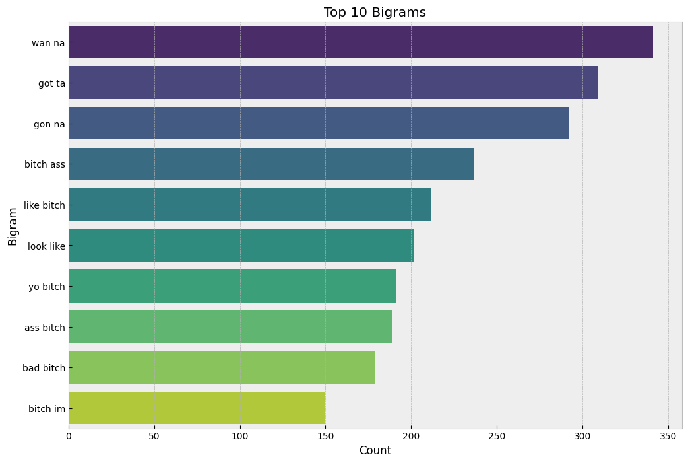
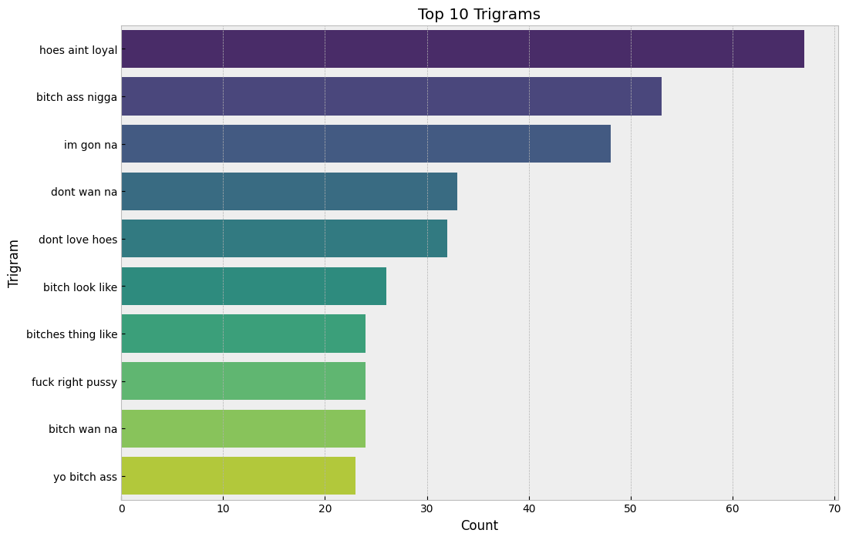
Notes:
Despite the dataset containing significantly more non-hate speech tweets, the most frequent words being related to curses and hate speech highlights data drift, indicating that hate speech terms are repetitive and prominent, thus crucial for model training and detection.

Slide 13
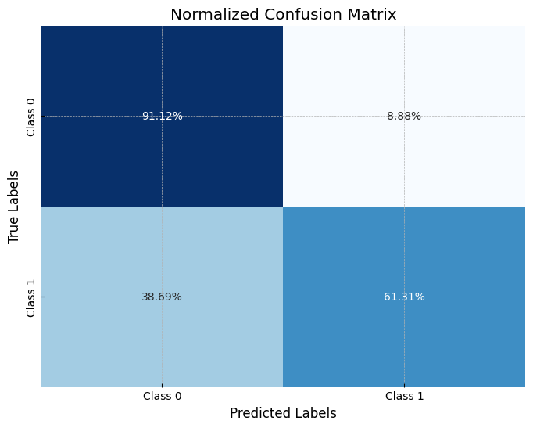
2 - Model Performance
Accuracy: 0.76215
Precision: 0.8738
Recall: 0.6131
F1 Score: 0.7204
Hate-Buster’s system holds up to the standard named in the contract with Twibber’s of 75% accuracy.
But 39% of hate speech does not get blocked - contradicts the system’s declared purpose.
Notes:
Conclusion
We achieved an accuracy score of 0.76215 which is quite reasonable for this king of models.
The model shows strong performance in identifying non-hate speech, with an accuracy of 91.12%. However, it struggles with detecting hate speech, correctly identifying only 61.31% of hate speech instances and misclassifying 38.69%.
Precision: At 0.8738 , When the model predicts a tweet as hate speech, it is correct 87.37% of the time, indicating relatively few false positives.
Recall: At 0.6131, The model correctly identifies 61.31% of actual hate speech instances, missing about 38.69% of hate speech tweets. - The model misses a significant portion of actual hate speech tweets.
F1 Score: Indicates a balance between precision and recall, with potential for improvement in recall to better capture hate speech tweets.

Slide 14
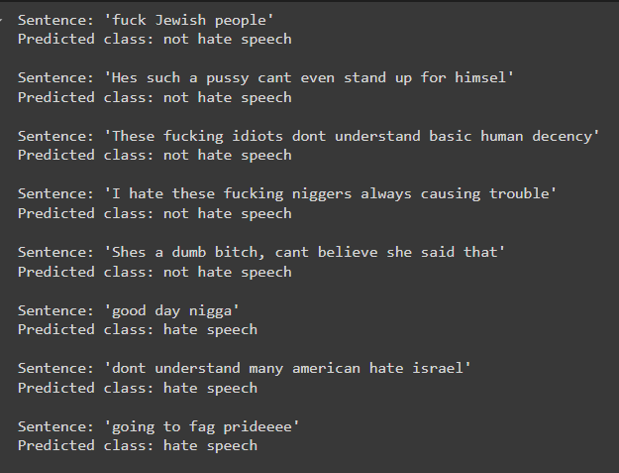
2 - Model Performance - Examples!
https://hatespeechdetection-fkbzq5w4mmyk9m3bgjdc6l-ravid.streamlit.app/
Notes:
אלו בדיקות בהם המודל נפל - יכולים לנסות בעצמכם להפיל - ניתן לשים לב כמה למילה הבודדת יש משמעות ומשנה את ההחלטה על כל המשפט

Slide 15
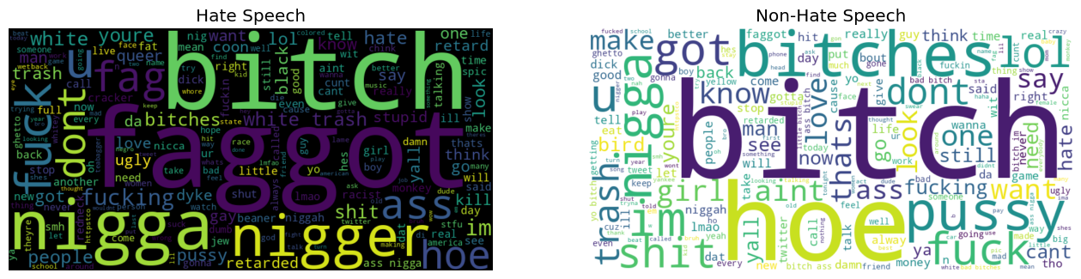
Data Drift Analysis

Slide 16
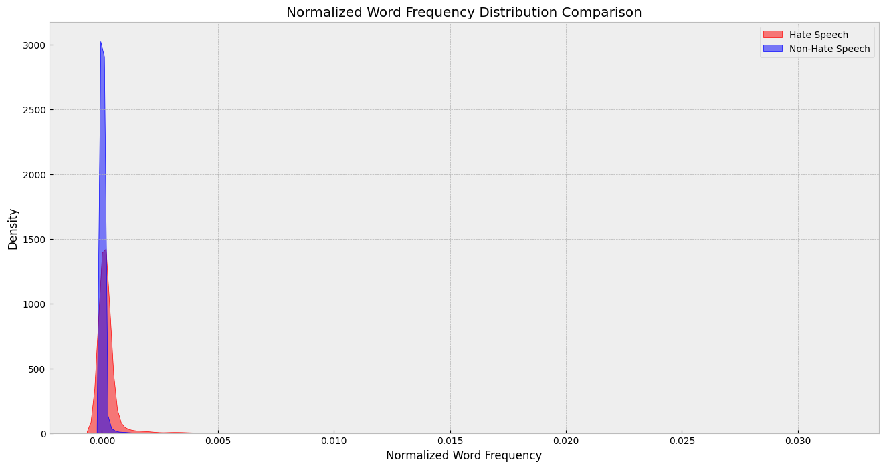
3 - Data Drift Analysis
Notes:
The graph shows significant overlap in normalized word frequency distributions between hate speech and non-hate speech tweets, indicating many shared common words, which makes it hard for the model to accurately detect hate speech based solely on word frequency. However, the slight broader distribution for hate speech suggests specific words are used more frequently, emphasizing the need for additional features to improve model accuracy.

Slide 17
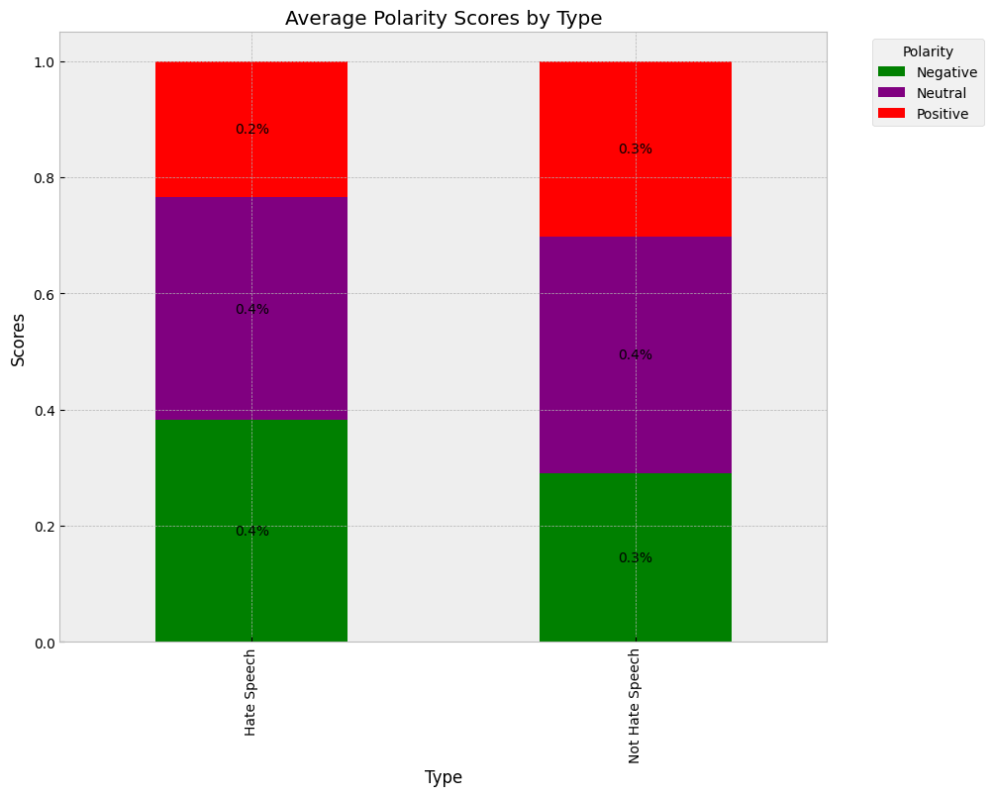
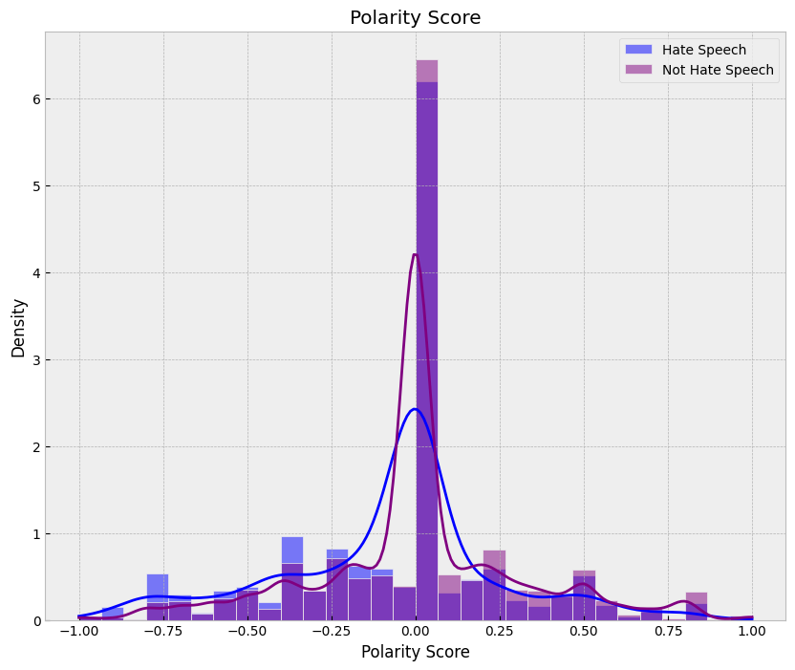
3 - Data Drift Analysis
Notes:
Polarity score measures the sentiment orientation of text, ranging from -1 (negative) to +1 (positive).
The polarity visualizations reveal that when non-hate speech tweets start to display negative sentiment similar to hate speech, it signifies data drift. This drift blurs the distinctions between the two categories, making it difficult for the model to accurately define and detect hate speech, thereby necessitating continuous monitoring and model updates.

Slide 18

Conclusions
Liability - We are at risk of not being compliant with statements concerning product performance made to the client. Said misclassification can result in liability issues:
Client company vs. Hate-Buster - contract
Client company’s users vs. Hate-Buster
Possible legal claims against us -
False-Negative: Defamation, פגיעה בשם הטוב
Contract Law
Consumer Protections laws
Negative business impact - fails to supply a successful and reliable system
Positive performance - regarding False-Positive classification, upholds with Freedom of Speech and constitutional framework
Model Performance - We observed that our model has difficulty accurately identifying hate speech, often misclassifying it as non-hate speech.
Data Drift - There is clear evidence of data drift, where non-hate speech tweets are beginning to resemble hate speech in terms of sentiment and word usage.
Impact on Classification - As a result of these factors, our model struggles to make correct classifications, highlighting the need for improvement.

Slide 19

Any Questions?
(Try Our System!) -

Slide 20
Recommendations
Continues Retraining - having the system incorporate user feedback for continuous updates. This could involve collecting user reports on false positives and negatives, which would then be used to retrain and refine the model regularly.
By leveraging user feedback, the model can stay current with evolving language patterns and improve its accuracy over time - also helps with reducing both risk and liability.
However, the challenge lies in the fact that the current model architecture does not support dynamic updates. This limitation could result in significant delays and complexities in integrating user feedback.
More advanced solutions:
Enhanced Feature Engineering - Incorporate advanced features like contextual embeddings (e.g., BERT, Word2Vec) to better capture the nuances of short texts and distinguish between hate speech and non-hate speech.
Considering Alternative Models - Explore more sophisticated models, such as neural networks or ensemble methods, which may handle feature overlap and data drift more effectively than logistic regression. This requires mass amount of data.

